Slide 1
Programming with OpenGL
Part 2: Complete Programs
Ed Angel
Professor of Emeritus of Computer Science
University of New Mexico

Slide 2
Objectives
Build a complete first program
  Introduce shaders
  Introduce a standard program structure
Simple viewing
  Two-dimensional viewing as a special case of three-dimensional viewing
Initialization steps and program structure
Angel and Shreiner: Interactive Computer Graphics 7E © Addison-Wesley 2015

Slide 3
Program Execution
WebGL runs within the browser
  complex interaction among the operating system, the window system, the browser and your code (HTML and JS)
Simple model
  Start with HTML file
  files read in asynchronously
  start with onload function
    event driven input
Angel and Shreiner: Interactive Computer Graphics 7E © Addison-Wesley 2015

Slide 4
Coordinate Systems
The units in points are determined by the application and are called object, world, model or problem coordinates
Viewing specifications usually are also in object coordinates
Eventually pixels will be produced in window coordinates
WebGL also uses some internal representations that usually are not visible to the application but are important in the shaders
Most important is clip coordinates
Angel and Shreiner: Interactive Computer Graphics 7E © Addison-Wesley 2015

Slide 5
Coordinate Systems and Shaders
Vertex shader must output in clip coordinates
Input to fragment shader from rasterizer is in window coordinates
Application can provide vertex data in any coordinate system but shader must eventually produce gl_Position in clip coordinates
Simple example uses clip coordinates
Angel and Shreiner: Interactive Computer Graphics 7E © Addison-Wesley 2015

Slide 6
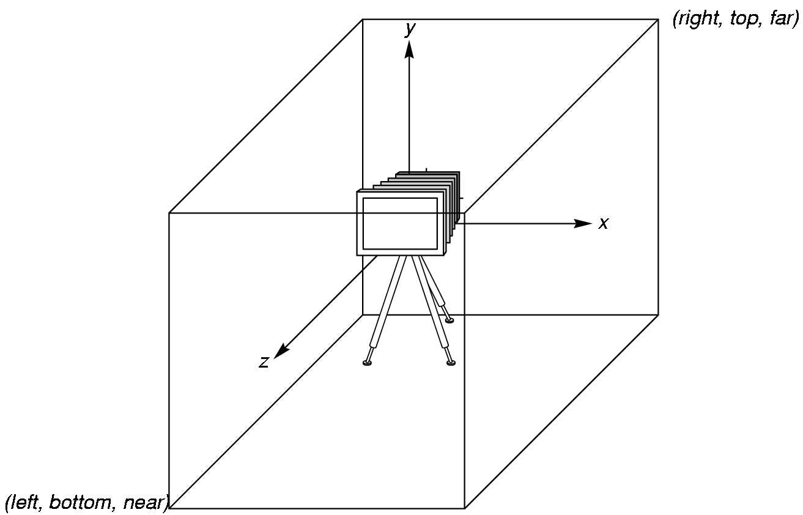
WebGL Camera
WebGL places a camera at the origin in object space pointing in the negative z direction
The default viewing volume
is a box centered at the
origin with sides of
length 2
Angel and Shreiner: Interactive Computer Graphics 7E © Addison-Wesley 2015

Slide 7
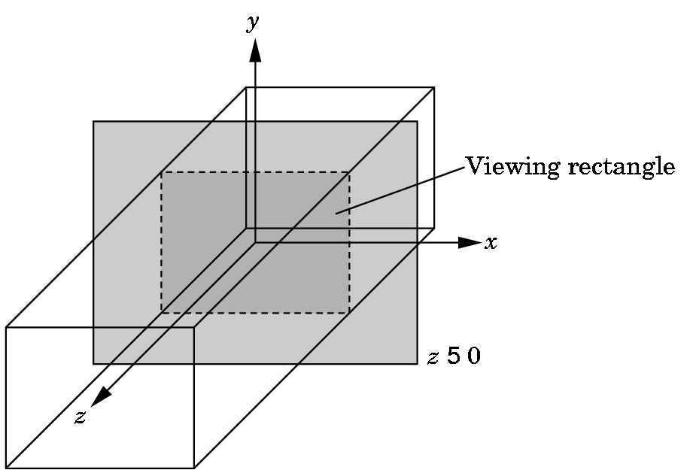
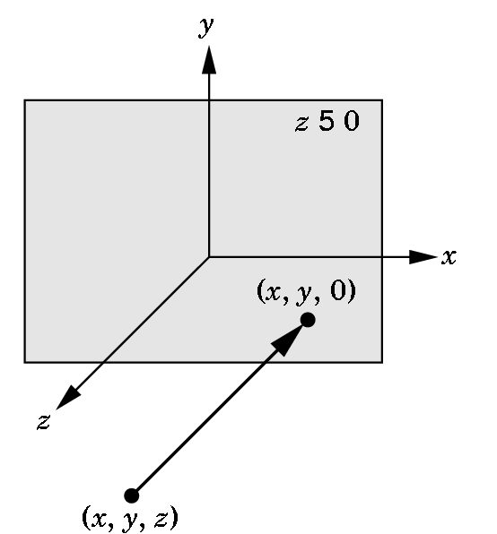
Orthographic Viewing
In the default orthographic view, points are
projected forward along the z axis onto the
plane z=0
z=0
z=0
Angel and Shreiner: Interactive Computer Graphics 7E © Addison-Wesley 2015

Slide 8
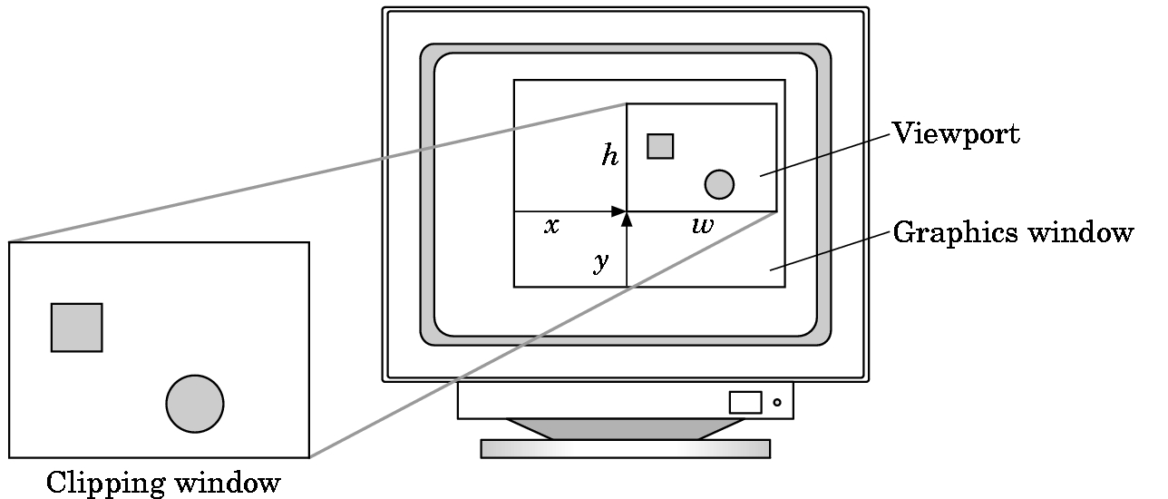
Viewports
Do not have use the entire window for the image: gl.viewport(x,y,w,h)
Values in pixels (window coordinates)
Angel and Shreiner: Interactive Computer Graphics 7E © Addison-Wesley 2015

Slide 9
Transformations and Viewing
In WebGL, we usually carry out projection using a projection matrix (transformation) before rasterization
Transformation functions are also used for changes in coordinate systems
Pre 3.1 OpenGL had a set of transformation functions which have been deprecated
Three choices in WebGL
  Application code
  GLSL functions
  MV.js
Angel and Shreiner: Interactive Computer Graphics 7E © Addison-Wesley 2015

Slide 10
First Assignment: Tessellation and Twist
Consider rotating a 2D point about the origin
Now let amount of rotation depend on distance from origin giving us twist
Angel and Shreiner: Interactive Computer Graphics 7E © Addison-Wesley 2015

Slide 11
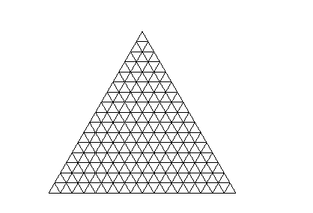
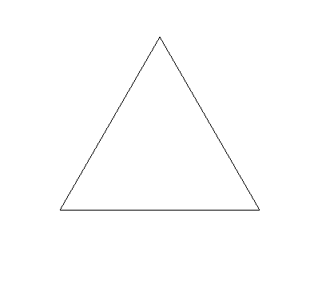


Example
triangle
tessellated triangle
twist without tessellation
twist after tessellation
Angel and Shreiner: Interactive Computer Graphics 7E © Addison-Wesley 2015

